Slide 1
API Testing with Postman
for Simple Books API
Software Tester (ALX2_SWD6_G1)
Group 2
GitHub Repository Link

Slide 2
Introduction
API Testing ensures endpoints behave as expected.
Postman is a powerful tool for API development and testing.
This project uses Postman and the 'Simple Books API' for hands-on learning.

Slide 3
Project Objectives
Automate functionality testing of a RESTful API using Postman.
What it validates:
Correct behavior of API endpoints.
CRUD operations (Create, Read, Update, Delete) for clients, books and orders.
Use variables and scripting to create dynamic test flows.
Generate and interpret test results.

Slide 4
Test Plan Overview
A total of 15 test cases (requests) were implemented, comprising 25 tests (assertions).
Covers status check, registration, book and order operations.
Both valid (pass) and invalid (fail) scenarios tested.

Slide 5
Tools Used
Simple Books API: A sample API used to test various HTTP methods, authentication, and validation logic.
Postman: For sending API requests, writing test scripts, and managing collection.
JavaScript: Used for writing custom test assertions and handling error scenarios.
Newman: Command-line tool for running Postman collections outside the GUI and automating test execution.
newman-reporter-htmlextra: Reporter used with Newman to generate detailed, visually rich HTML test reports.

Slide 6
Key Insights
Visualized with Screenshots

Slide 7
API Endpoints Covered
GET/status
Test 02
List of books
GET/books
Tests 03, 04
Get a single book
GET/books/:bookId
Test 01
Status
POST/api-clients/
Tests 05, 06
API Authentication

Slide 8
API Endpoints Covered
Test 09
GET/orders
Get an order
GET/orders/:orderId
Get all orders
DELETE/orders/:orderId
Tests 12, 13
Update an order
Tests 14, 15
Delete an order
PATCH/orders/:orderId
Tests 07, 08
Submit an order
POST/orders
Tests 10, 11

Slide 9
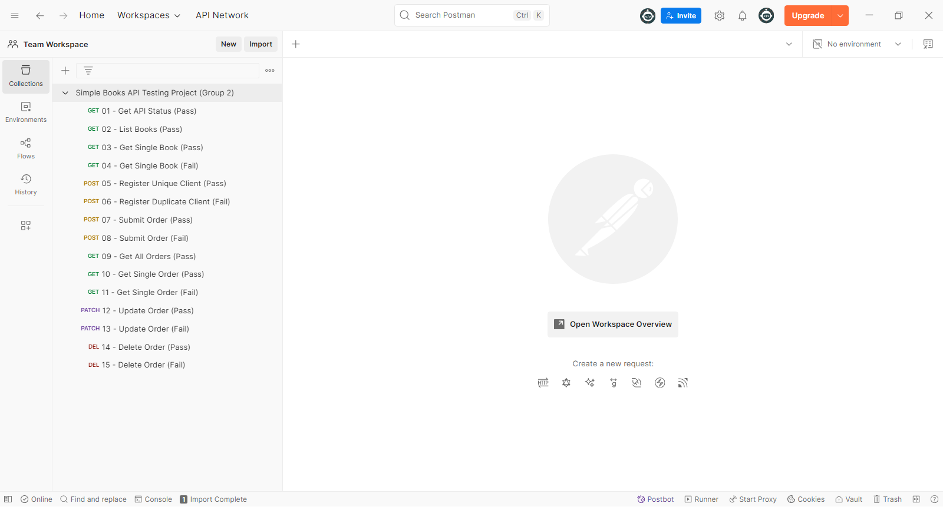
Collection Structure

Slide 10
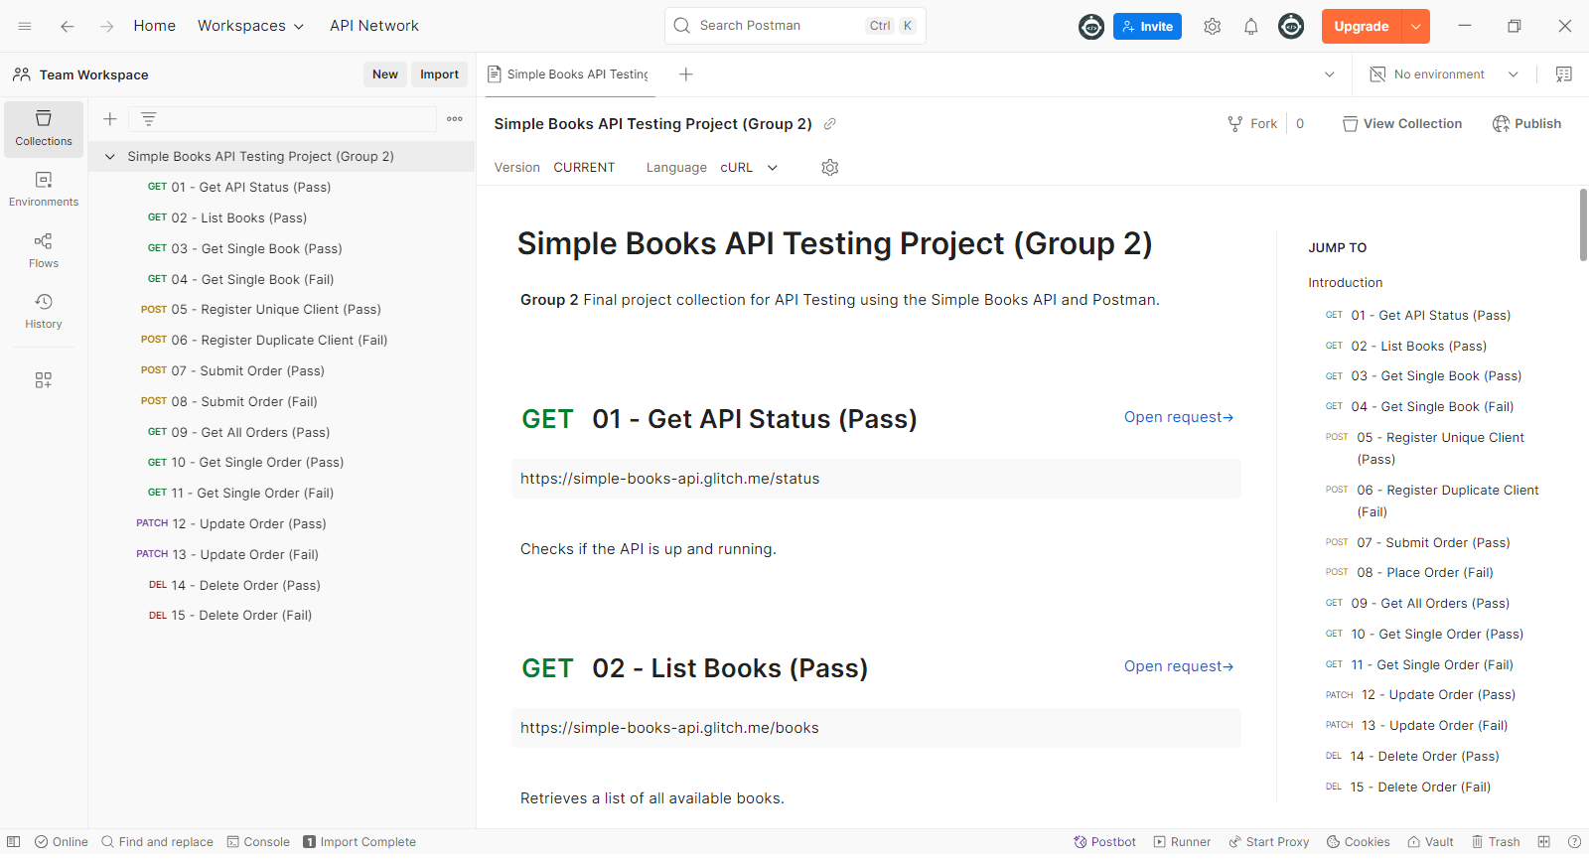
Documented Collection with Requests Descriptions

Slide 11
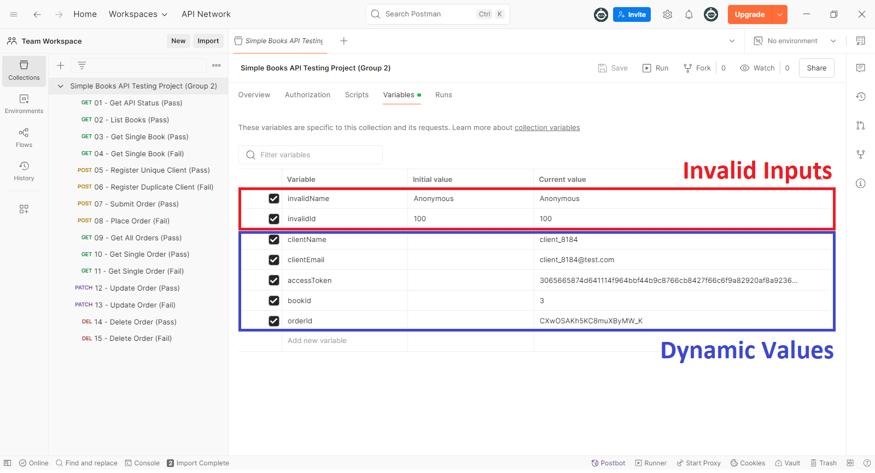
Using Collection Variables for Storing Invalid Inputs and Obtaining Dynamic Values

Slide 12
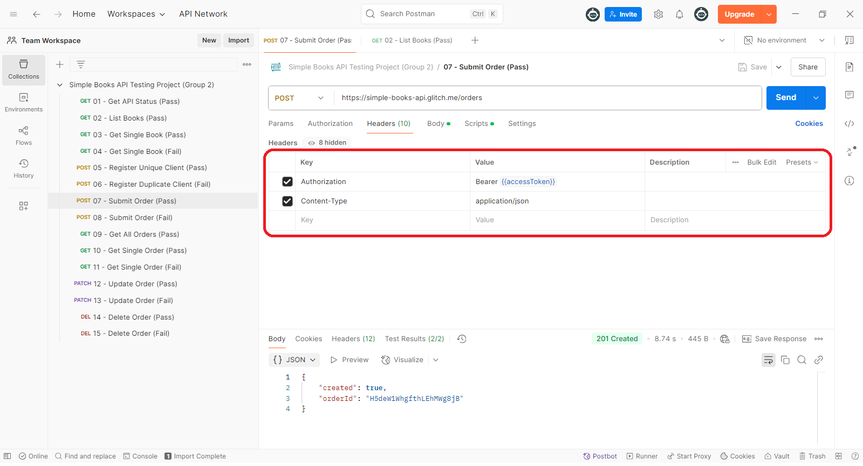
Test 07: Submit Order (Pass) Used authorization header with Bearer token

Slide 13
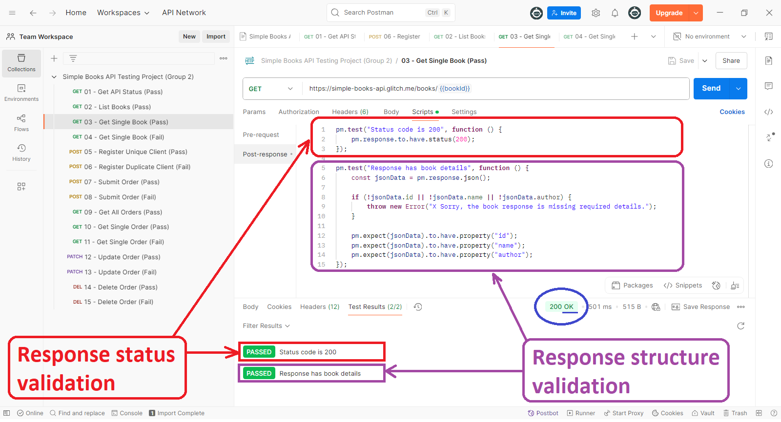
Test 03: Get Single Book (Pass) Test scripts to validate response status and structure

Slide 14
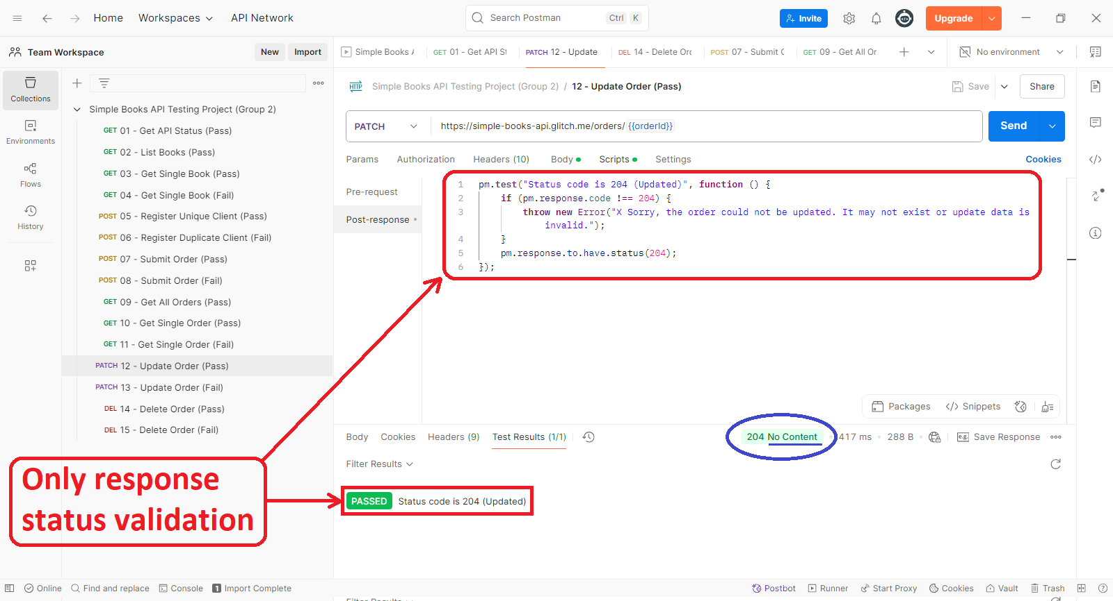
Test 12: Update Order (Pass) Test script to validate response status only

Slide 15
Pass Test Example
Test: 01 - Get API Status.
Checks if API is up and returns status 200.
Asserts that response JSON includes 'status: OK’.

Slide 16
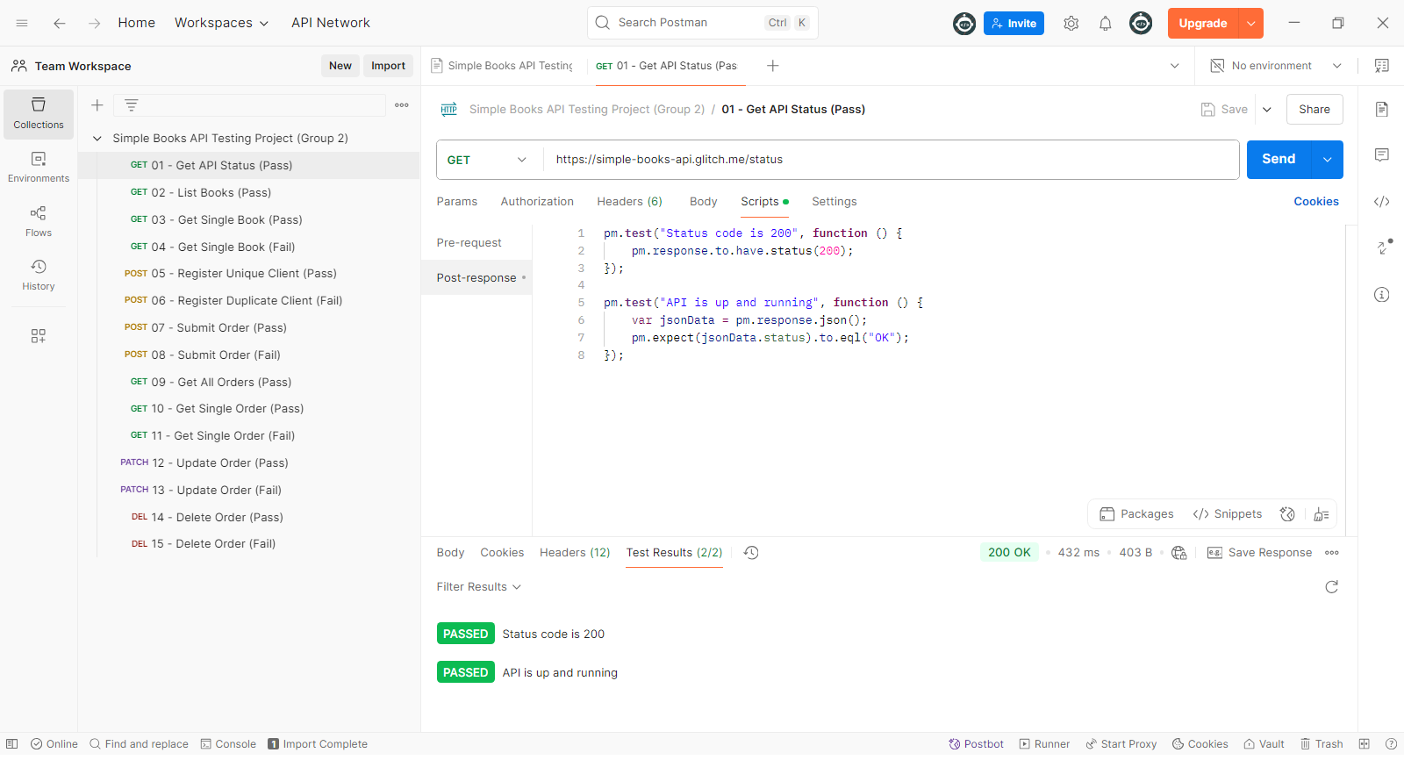
Test 01: Get API Status (Pass) Example Pass Test

Slide 17
Fail Test Example
Test: 06 - Register Duplicate Client.
Attempts to register same client twice.
Fails as email must be unique – useful to check validations.

Slide 18
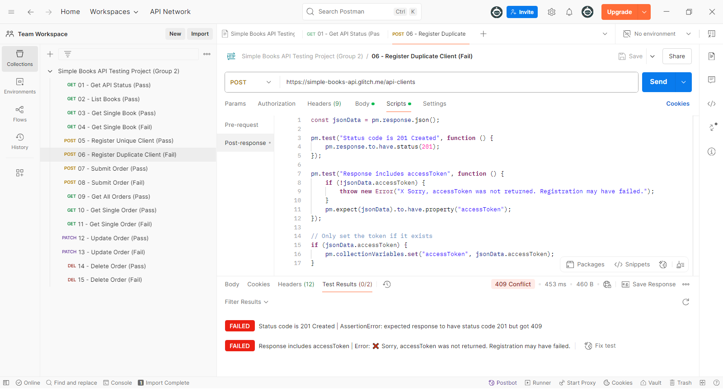
Test 06: Register Duplicate Client (Fail) Example Fail Test

Slide 19


Collection Run (Recording)

Slide 20
Summary of Results
Passed Tests: 9
Fail Tests: 6
Intentionally triggered to verify invalid cases.
The collection tests validated expected API behavior.

Slide 21





Test Outcome Summary
Request Name | Overall Status
01 - Get API Status (Pass) | Pass
02 - List Books (Pass) | Pass
03 - Get Single Book (Pass) | Pass
04 - Get Single Book (Fail) | Fail
05 - Register Unique Client (Pass) | Pass
06 - Register Duplicate Client (Fail) | Fail
07 - Submit Order (Pass) | Pass
08 - Place Order (Fail) | Fail
09 - Get All Orders (Pass) | Pass
10 - Get Single Order (Pass) | Pass
11 - Get Single Order (Fail) | Fail
12 - Update Order (Pass) | Pass
13 - Update Order (Fail) | Fail
14 - Delete Order (Pass) | Pass
15 - Delete Order (Fail) | Fail
Pass Requests | 9
Fail Requests | 6

Slide 22
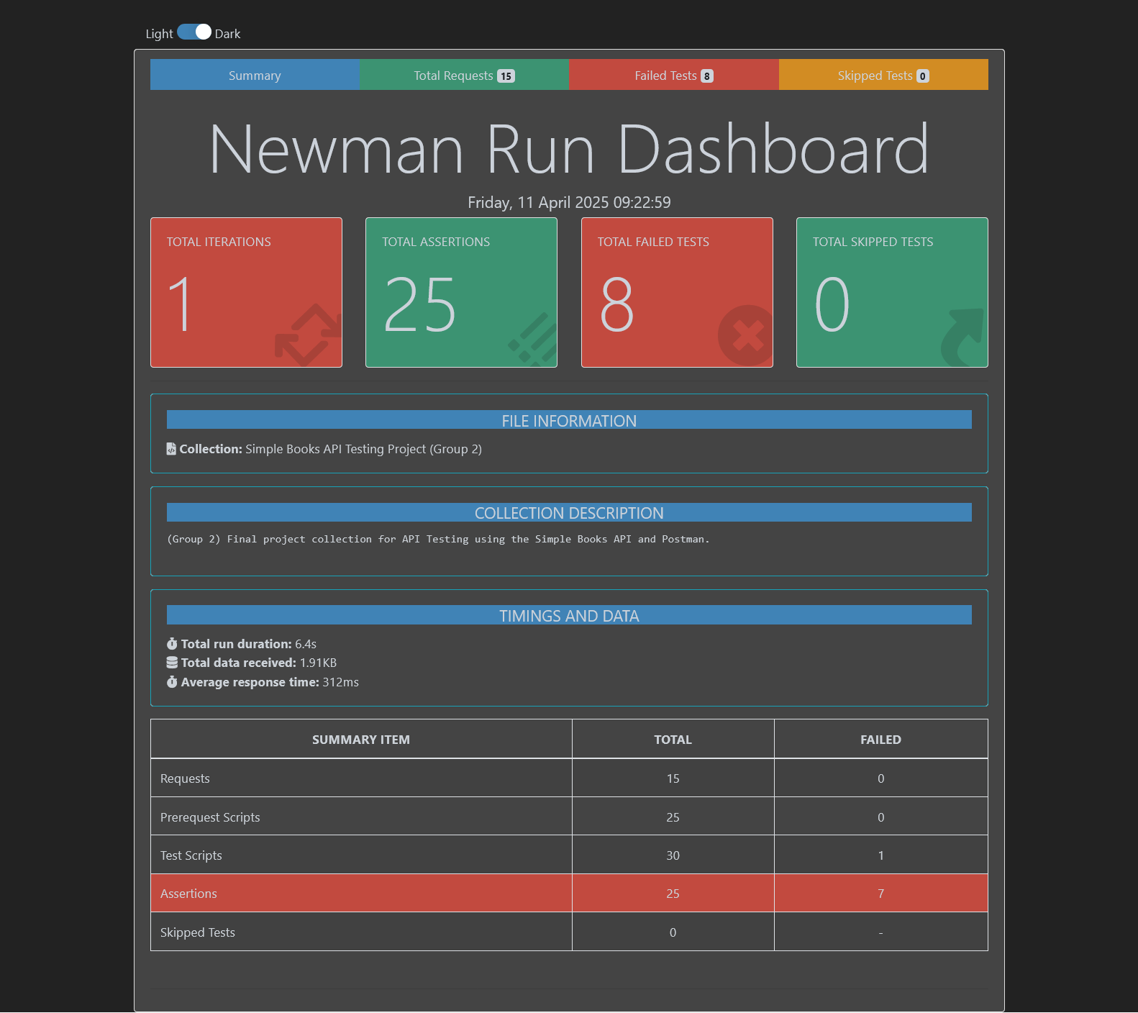
Test Outcome Report Summary

Slide 23
Test Outcome Report Summary

Slide 24
Test Outcome Report Summary

Slide 25
Conclusion
Gained hands-on experience with API testing tools.
Learned how to structure tests and validate outcomes.
Important to include negative tests to cover real-world scenarios.

Slide 26
Thank You
Questions?

